Slide 1
The CEF Telecom calls & evaluation process

Slide 2
Call information

Slide 3
Call management
INEA manages the CEF programme & calls on behalf of the European Commission
European Commission Defines the policy Defines strategy, objectives and priority areas/work programmes Selects projects for co-financing Makes programme decisions Evaluates the programme and the Agency's performance | Innovation & Networks Executive Agency (INEA) Turns policy into action Organises calls for proposals Monitors the technical and financial implementation of projects Manages project lifecycle Ensures sound financial management

Slide 4
How do the calls work?
Legal basis:
  CEF Regulation (Regulation No 1316/2013)
  Telecom Guidelines (Regulation No 283/2014)
  EU Financial Regulation and Rules of Application
2016 Annual Work Programme:
  Adopted 3 March (available on call page on INEA website)
  Outlines general CEF Telecom objectives and priorities for actions to be funded in a specific year
Specific call text:
  Launched by INEA - together with application forms and various guidance documents
  Outlines all conditions of call

Slide 5
2016 CEF Telecom calls
Call | Indicative budget | Launch date | Deadline
CEF-TC-2016-1 BRIS EESSI eProcurement | €3 million €24.5 million €4.5 million | 3 March 2016 | 19 May 2016
CEF-TC-2016-2 eDelivery eID & eSignature eJustice Public Open Data | €0.5 million €4.5 million €2 million €3.5 million | 12 May 2016 | 15 September 2016
CEF-TC-2016-3 Automated Translation Cybersecurity eInvoicing Europeana | €6.5 million €12 million €7 million €2 million | 13 September 2016 | 15 December 2016

Slide 6
eDelivery

Slide 7
2016-2 eDelivery call: scope
Increase uptake and speed up the use of the eDelivery DSI amongst public and private entities
Contribute to the compliance with the requirements set in the eIDAS Regulation to allow their use for the provisioning of electronic registered delivery services, including qualified ones
Contribute to the compliance with the requirements set in relation to the deployment and/or operation of access points within other sectorial European Regulations (e.g. eInvoicing, transport, environment, energy, health, public e-procurement, justice).
  This will be done via the setting up of additional access points and service metadata publishers throughout Europe that link to the EU Core Service Platform

Slide 8
2016-2 eDelivery call: expected outcomes
Helping access point and service metadata publishers to enable interoperability between European and national levels - regardless of the standards in use within each of the Member States.
Ensuring convenient and secure cross-border transactions by allowing the implementation of interoperable solutions working within the trusted legal framework for electronic registered delivery services provided in the eIDAS Regulation

Slide 9
2016-2 eDelivery call: key conditions
Who can apply?
  One or more Member States + EEA countries (Norway/Iceland)
  International organisations, joint undertakings, or public or private undertakings or bodies established in Member States - ith the agreement of the Member States/EEA countries concerned
Consortium composition: minimum of 4 entities from one or more Member States
Co-financing: 75% of the eligible costs of the action
Indicative duration: 24 months

Slide 10
eID & eSignature

Slide 11
2016-2 eID & eSignature call: scope
Integration of the eID and/or eSignature DSI in an existing e-service/system
/online platform operating cross border to enable private and public sector entities (including local administrations) to accept issued eIDs and eSignatures from any Member State
eID:
Primary focus on a few selected private sector areas presenting potential high volume cross-border transactions (i.e banking, electronic/Internet payment services, other financial services, insurance and aviation)
eSignature:
Support for public sector entities involved in the establishment and operation of the points of single contact under the Services Directive, as well as by public sector bodies in view to comply with the requirements set in the eIDAS Regulation
Integration of the tools provided by the eSignature DSI by public sector bodies in order to facilitate the cross-border completion of electronic procedures by companies applying for administrative decisions with public administrations of other Member States.
Priority to the public and private sector bodies which manage the points of single contact under the Services Directive

Slide 12
2016-2 eID & eSignature call: expected outcomes
Increasing the widespread uptake and use of eID by the private sector - which are potentially the largest users and contributors to the Digital Single Market
Improving the cross-border acceptance of eSignatures by public sector bodies, promoting business mobility and increasing the interoperability of eSignatures

Slide 13
2016-2 eID & eSignature call: key conditions
Who can apply?
  One or more Member States + EEA countries (Norway/Iceland)
  International organisations, joint undertakings, or public or private undertakings or bodies established in Member States - ith the agreement of the Member States/EEA countries concerned
Consortium composition: minimum of 4 entities from one or more Member States
Co-financing: 75% of the eligible costs of the action
Indicative duration: 12 months

Slide 14
European e-Justice Portal

Slide 15
2016-2 European e-Justice Portal call: scope
Encourage the interconnectivity (development, deployment, testing and generic services in EU Member States which will allow the modules of the e-Justice Portal to serve a greater audience and thus better fulfil their public function.
  Interconnection of Insolvency Registers
  Find a lawyer/Find a notary
  European Case Law Identifier (ECLI)
  Access to e-CODEX
  European Court Database

Slide 16
2016-2 European e-Justice Portal call: expected outcomes
Interconnection of Insolvency Registers:
  Improving the provision of relevant and timely information to creditors and courts involved and preventing the opening of parallel insolvency proceedings.
  Allowing certain Member States to expediently comply with the requirements of the EU Regulation on insolvency proceeding
  Interconnecting Member State insolvency registers via the European e-Justice Portal
Find a lawyer/Find a notary:
  Facilitating access to justice in particular in a cross-border context
  Extending and completing coverage in terms of Member State participation
  Providing a comprehensive EU-wide search engine for finding members of these two legal professions across Europe
European Case Law Identifier (ECLI):
  Implementing technical solutions allowing access to national case law at the national and European levels in compliance with the ECLI standard

Slide 17
2016-2 European e-Justice Portal call: expected outcomes
Access to e-CODEX:
  Enlarging the Member State coverage where electronic use of the European Order for Payment and the European Small Claims cross-border legal instruments is possible, and thus enabling courts to receive electronic submissions of claims from citizens, business and legal practitioners across the EU
European Court Database:
  Enabling a smoother and enhanced process of Member State data provision to the Database, resulting in more up-to-date and accurate information

Slide 18
2016-2 European e-Justice Portal call: key conditions
Who can apply?
  One or more Member States + EEA countries (Norway/Iceland)
  International organisations, joint undertakings, or public or private undertakings or bodies established in Member States - ith the agreement of the Member States/EEA countries concerned
Consortium composition: no specific requirements, but please see section 3 of the call text for more info about who can apply for which generic service
Co-financing: 75% of the eligible costs of the action
Maximum duration: 24 months

Slide 19
Public Open Data

Slide 20
2016-2 Public Open Data call: scope
Continue the support to the generation, aggregation and cross-border/cross domain harmonisation of open datasets at all levels of government, including cities, integrating the support provided by the CEF Telecom 2015 work programme
Foster the availability of harmonised and detailed datasets content description for their full and informed use

Slide 21
2016-2 Public Open Data call: expected outcomes
Boost the development of information products and services based on the re-use and combination of open public data across the EU and contribute in particular to:
  Improve the availability of harmonised content at the EU level
  Increase the transparency and availability of innovative services for citizens; increase the overall efficiency of public services and administrations.
  Assist the innovation ecosystems of startups/development of apps, which can strongly benefit from open data and platforms
  Promote the availability of good quality, reliable and interoperable datasets and enabling data portals infrastructure to allow the full potential of Open Data to be exploited
  Support the functioning of the European Data Portal as the one-stop-shop for Open Data across the EU
  Support the priorities of Digital Single Market, boosting competitiveness through cross-border interoperability and standardisation and facilitating easy interaction with citizens

Slide 22
2016-2 Public Open Data call: key conditions
Who can apply?
  One or more Member States + EEA countries (Norway/Iceland)
  International organisations, joint undertakings, or public or private undertakings or bodies established in Member States - ith the agreement of the Member States/EEA countries concerned
Consortium composition: minimum of 2 public administrations from two different Member States
Co-financing: 50% of the eligible costs of the action
Indicative duration: 24 months

Slide 23
Call evaluation process

Slide 24
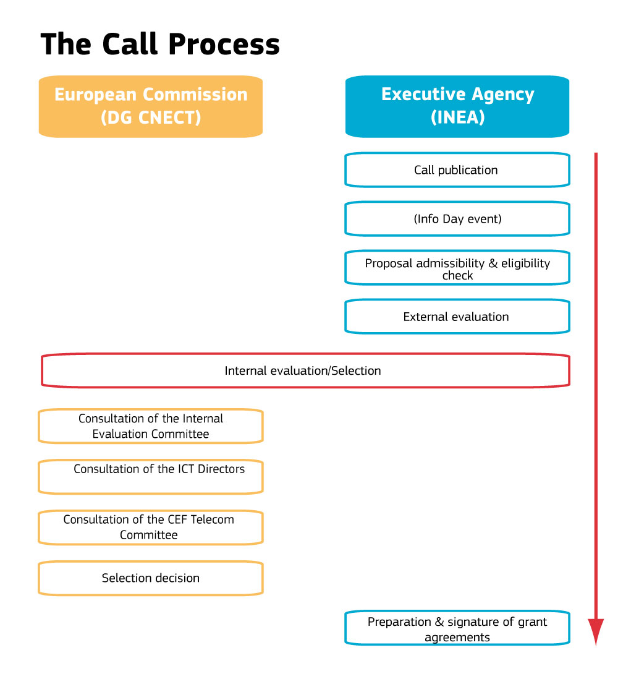

Slide 25
Principles for the evaluation and selection process
Basis: eligibility, selection and award criteria of the work programme and the call for proposals
Equal treatment: all proposals evaluated against the same criteria; no preferential treatment to any applicant
Transparency: adequate feedback to applicants on the outcomes of the evaluation

Slide 26
Call publication & application support
Call published in Official Journal and announced on specific call page on INEA website
Call texts, Guide for Applicants, application forms prepared by INEA and available on call page at publication
Helpdesk operational as of call publication: FAQs now available on call page
Virtual Info Day: 3 June 2016

Slide 27
Admissibility/Eligibility Committee (INEA)
Checks compliance with admissibility conditions, eligibility and selection criteria
  Proposal submitted on time, complete, signed by the applicant
  Applicants demonstrate the support of the concerned Member State and are not in an exclusion situation
  Proposal addresses the DSI in question and has the right consortium composition
  Applicant has the financial and technical capacity to carry out the action
  Proposal complies with relevant EU legislation (public procurement)

Slide 28
Technical Evaluation: overview
Independent external experts provide technical assessment on the basis of the information submitted in a proposal in a two-step process:
1. Individual reading of proposals (remote or onsite at INEA)
2. Consensus meeting for each proposal (onsite at INEA)
  Experts and an INEA moderator meet to agree on comments and scores for the award criteria
  The proposal must have at least 3 points for each criterion to be considered for funding.
  Overall threshold = 10 points (applying to the sum of the three individual scores)

Slide 29
Award criteria
Relevance
Quality & efficiency of implementation
Maturity
Impact & sustainability
Alignment to DSI implementation objectives & activities (WP)
Quality of the approach to facilitate wider deployment/take-up of the proposed actions
Coherence/effectivess with work plan
Quality of consortium/consortium members
Support from national authorities/industry/NGOs
Attention to security/privacy/
inclusiveness/accessibility
Alignment to EU/national policies, strategies and activities
Capability of long-term sustainability without EU funding

Slide 30
Internal Evaluation
  Done by the Commission
  Does not re-evaluate the proposals but uses the experts recommendations to prepare a ranking list (and any reserve lists)
  Identifies potential double funding and/or any other issues that would influence the selection of proposals
  Discusses where appropriate any potential transfer of budget from one call to another

Slide 31
Selection Decision
Member States approve the Selection Decision in the CEF Coordination Committee
European Parliament is informed on the list of selected projects
Selection Decision is adopted formally by the Commission
Publicity actions (i.e. press release) carried out after adoption of Selection Decision

Slide 32
Grant agreement
Once Decision is adopted, successful applicants are invited to by INEA to prepare the individual grant agreement
Grant agreement is signed between the beneficiaries (applicants) and INEA and covers the technical, legal and financial aspects of the proposal based on evaluation results
Model grant agreement is published on INEA website on the call page
Project management carried out by INEA

Slide 33
How to apply

Slide 34
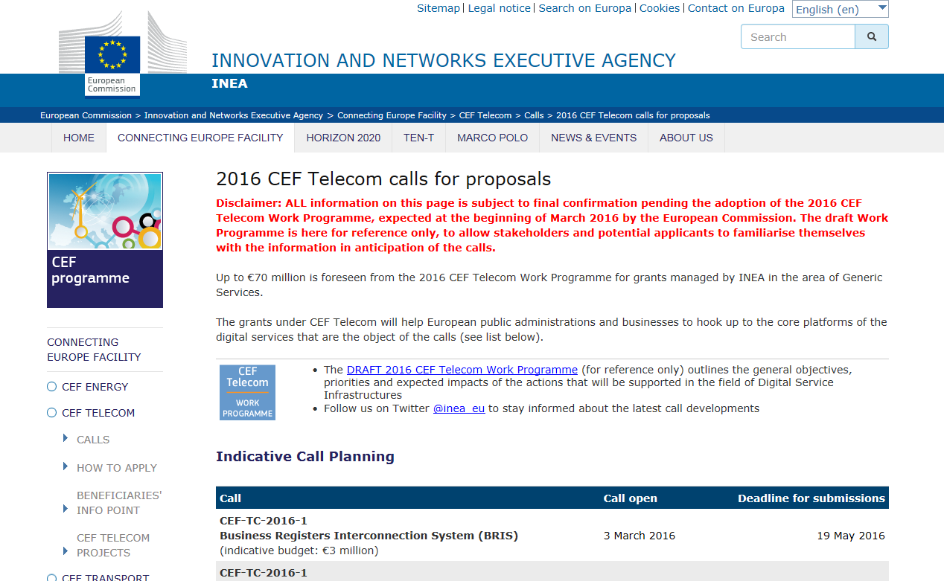
Before you get started…
Read through all of the call
documents on the call webpage,
especially:
  Work Programme (Annex)
  Call text
    Take special note of the Priorities (section 3) and Results (section 4) which provide specific information on what is expected in the proposals
    Carefully read the Award Criteria (section 10) which explain on what the proposal will be evaluated
  Guide for Applicants

Slide 35
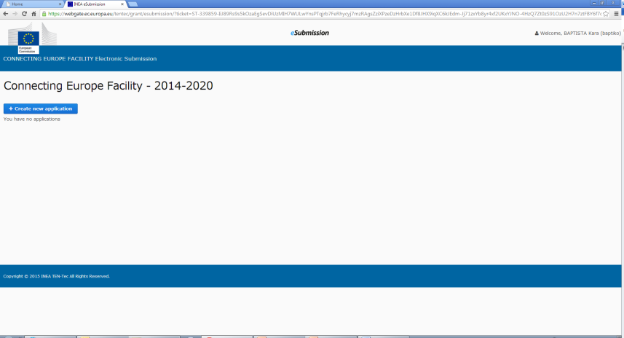
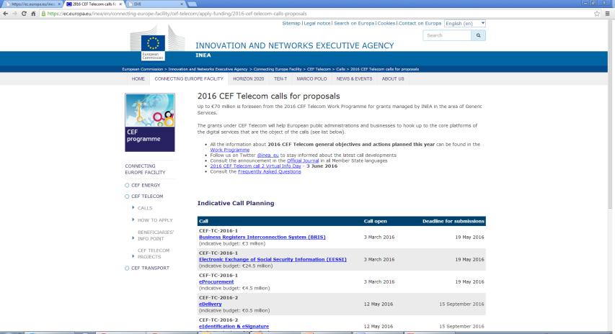
Proposal submission
Fully electronic proposal submission done via TENtec – system used to manage the CEF projects during their entire lifecycle and which enables the electronic submission of proposals under the CEF calls
All application forms and access to TENtec eSubmission module available via call page on INEA website

Slide 36
Application form
Application Form
Part A
Main characteristics of the proposal
Part B
Administrative information
Part C
Information on compliance with EU law
Part D
Technical and financial information

Slide 37
Application form A
Essential information on the applicants and on the proposal (summary of the action, timing, activities and milestones, budget and requested funding)
Must be completed in the TENtec eSubmission module, Word version provided for reference on call webpage
Includes forms that require signature of the applicants (A2.2) and Member State validation (A2.3)
Be complete, informative and precise: the descriptions of the proposed Action and activities will also be used for the grant agreement

Slide 38
Application form B
Further administrative information on applicants and info use to demonstrate compliance with the financial & operational capacity
Legal entity form, financial identification form, additional supporting documents
Member States, third countries, public entities established in the EU and international organisations DO NOT need to demonstrate financial and operational capacity
Annexes B-I, B-II, B-III, B-IV to be completed, signed, stamped (B-III), and uploaded if applicable

Slide 39
Financial and operational capacity check
Application form B
Required by Financial Regulation
Financial capacity check
Financial analysis based on a set of ratios, carried out as same time as evaluation – applicants to supply information based on amount of grant requested
Operational capacity check
Proof of technical and operational capacity of applicant to complete the proposed Action
  Complements information from application form D2.3
  Proof: activity report, CVs, reports on similar projects, etc

Slide 40
Application form C
Information on compliance with EU law on public procurement
Information on other sources of EU financing that may be received by the proposal (cannot receive grants from two EU funding sources)

Slide 41
Application form D
Detailed, technical information describing the proposed Action and its activities – i.e. the heart of the proposal
Order of the questions reflects the award criteria – address each point and subpoint in your application to ensure that your proposal contains all of the relevant information on which it will be assessed.
Don't forget the Gantt chart/other annexes

Slide 42
Tips to improve your proposal: content
Provide ALL relevant information on the application forms - don’t rely on additional supporting documents
Be consistent in describing the objective, activities, duration and budget in your responses to different questions and parts of the application form
Present a clear time table and planning overview, explain possible risks and delays and provide evidence that these are being addressed
Show evidence that the proposed Action supports the objectives/aims of the call + addresses the award criteria
Justify why the financial support is needed
Use simple, clear language! Responses need to be clear, well-structured, substantiated and concise -> experts have limited time to read and assess the proposals

Slide 43
Tips to improve your proposal: process
Start early (especially for Member State endorsement and multi-applicant proposals)
Save your proposal often in the system
Avoid upoading all supporting documents and information at the last minute
Visit your call webpage regularly to check for updates, sign up for our Twitter feed for notifications

Slide 44
Guidance and help available
Call webpage:
  Work programme
  Call texts
  Other key legal and technical documents
  Member State contact points
  Useful links
Guide for Applicants
Presentations and video footage from 3 June Info Day
Proposal checklist

Slide 45
Guidance and help available
Helpdesk: INEA-CEF-Telecom-calls@ec.europa.eu
FAQs (general and DSI specific) and FAQ notification service
  Where relevant for all applicants: answers published in FAQs (no individual responses!)
  Where too specific to a proposal and would provide a comparative advantage: not answered
  FAQ deadline (2016-2): Thursday 1 September - last FAQ update online Thursday 8 September
  Individual responses will be provided until the deadline on technical questions related to TENtec eSubmission module

Slide 46
Submitting the application
Follow the steps as detailed in the Guide for Applicants
  Part A must be filled in TENtec eSubmission module
  Parts B, C and D can be completed in native applications and uploaded as attachments
Upload all forms requiring signatures (e.g. A2.2, A2.3, Annexes B-I, B-II, B-III) – make them clearly identifiable by their title
Don't forget any supporting documents
Keep your originals – they may be requested later
Submit in TENtec before the deadline:
Thursday, 15 September 2016, 17:00.00 (Brussels time)

Slide 47
Next steps (indicative)
September-December 2016: evaluation
January-February 2017: legislative process and adoption of the Selection Decision
Starting from February 2017: announcement of results and negotiation of individual grant agreements for the successful proposals
Best of luck!

Slide 48

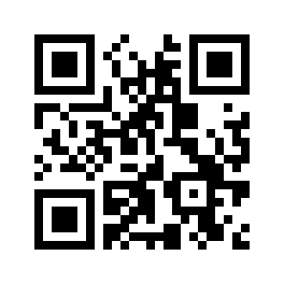


For more information
inea-cef-telecom-calls@ec.europa.eu
inea@ec.europa.eu
http://ec.europa.eu/inea
https://ec.europa.eu/inea/en/connecting-europe-facility/cef-telecom/apply-funding/2016-cef-telecom-calls-proposals
@inea_eu

